Slide 1
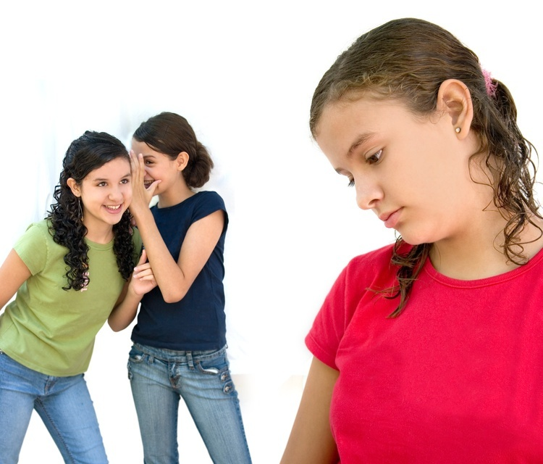
BULLYING 2012-2013

Slide 2
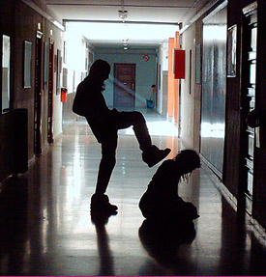
What Is The Definition of Bullying?

Slide 3
Bullying happens when someone hurts or scares another person on purpose, and the person being bullied has a hard time defending himself or herself. Usually, bullying happens over and over.

Slide 4
Bullying is…
Calling someone hurtful and derogatory names
Spreading lies and bad rumors about someone
Being mean and teasing someone
Hitting, punching, shoving, spitting and physically hurting someone

Slide 5
Bullying is…
Social exclusion or isolation ... not including someone in a group
Getting certain kids or teens to "gang up" on others
Having money or other things taken or damaged
Being threatened or being forced to do things

Slide 6
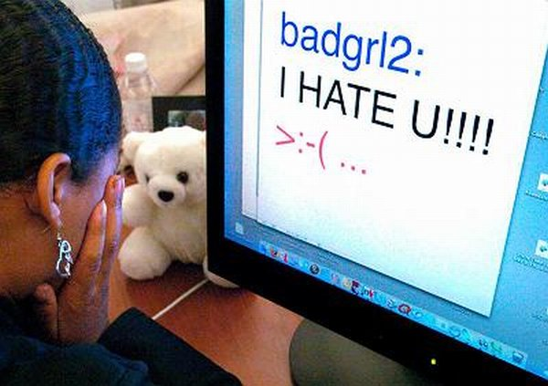
Bullying also can happen online or electronically.

Slide 7
Cyber-bullying is when people bully each other using the Internet, mobile phones, or other cyber technology.

Slide 8
This includes:
Sending mean text, e-mail, or instant messages
Posting nasty pictures or messages about others in blogs or on Web sites
Using someone else's user name to spread rumors or lies about someone
Stealing someone's password and spreading rumors about someone else making it seem like that person is the Cyberbully

Slide 9
Bullying comes In various forms:
Physical Bullying is the most obvious form of intimidation and can consist of kicking, hitting, biting, pinching, hair pulling, and making threats. A bully may threaten to punch you if you don't give up your money, your lunch, etc.
Verbal Bullying often accompanies physical behavior. This can include name calling, spreading rumors, and persistent teasing.
Emotional Intimidation is closely related to these two types of bullying. A bully may deliberately exclude you from a group activity such as a party or school outing.

Slide 10
Racist Bullying can take many forms: making racial slurs, spray painting graffiti, mocking the victim's cultural customs, and making offensive gestures.
Sexual Bullying is unwanted physical contact or abusive comments.
Cyberbullying is one or a group of kids or teens using electronic means via computers and mobile phones (emails, Web sites, chat rooms, instant messages and texts) to torment, threaten, harass, humiliate, embarrass or target another kid or teen.

Slide 11
South Carolina State Law
SECTION 59-63-110. Citation of article.
This article may be cited as the “Safe School Climate Act”.
SECTION 59-63-120. Definitions.
As used in this article:
(1) “Harassment, intimidation, or bullying” means a gesture, an electronic communication, or a written, verbal, physical, or sexual act that is reasonably perceived to have the effect of:
harming a student physically or emotionally or damaging a student’s property, or placing a student in reasonable fear of personal harm or property damage; or
insulting or demeaning a student or group of students causing substantial disruption in, or substantial interference with, the orderly operation of the school.

Slide 12
Law continued
SECTION 59-63-130. Prohibited conduct; reports by witnesses.
(A) A person may not engage in:
(1) harassment, intimidation, or bullying; or
(2) reprisal, retaliation, or false accusation against a victim, witness, or one with reliable information about an act of harassment, intimidation, or bullying.
(B) A school employee, student, or volunteer who witnesses, or has reliable information that a student has been subject to harassment, intimidation, or bullying shall report the incident to the appropriate school official.

Slide 13
Greenwood District 50 Board Policy
Click for Board Policy

Slide 14
End of Module
Click Here to return to the Employee Training Page

