Slide 1
Religion in the Public School
Greenwood School District 50
2015

Slide 2
S. C. Code Ann. 59-17-140
“Effective July 1, 2001, each school district during annual in-service training shall provide a program of instruction for employees in the essentials of constitutional protections and prohibitions as they relate to religion and public school operations.”

Slide 3

Balance
“Public Schools may not inculcate nor inhibit religion. Schools must be places where religion and religious conviction are treated with fairness and respect.”

Slide 4
First Amendment
Congress shall make no law respecting an establishment of religion, or prohibiting the free exercise thereof, or abridging the freedom of speech, or of the press; or the right of the people peaceably to assemble, and to petition the government for a redress of grievances.

Slide 5
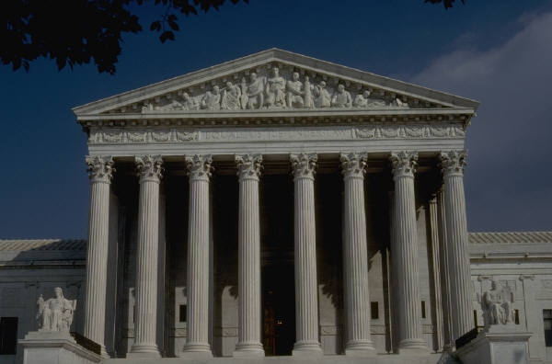
Lemon v. Kurtzma
The actions have a secular purpose;
The actions do not have the principal or primary effect of advancing or inhibiting religion;
The actions do not foster an excessive entanglement of government with religion.

Slide 6
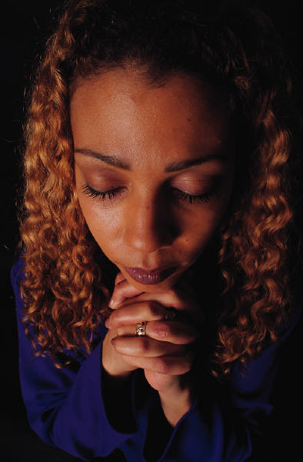
1. Student Prayers
Santa Fe Independent School District v. Doe 530 U. S. 290 (2000) Football
  The Court ruled prayer over a loudspeaker at a government sponsored event on government property (football game on district property) is a violation of the Establishment Clause

Slide 7
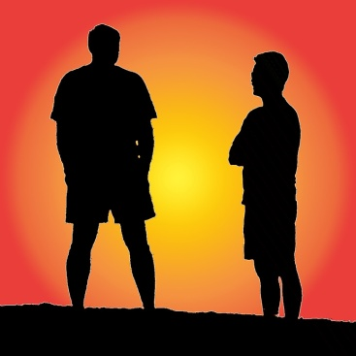
Student Prayer and
Religious Discussion
Establishment Clause does not prohibit purely private religious speech
Students may read Bibles, say grace, say prayer anytime it is not disruptive to the learning process
Informal gatherings are ok (Meet at Pole)
School may neither discourage or encourage

Slide 8

2. Graduation Prayers and Baccalaureate Activities
Lee v. Weisman 505 U. S. 577 (1992)
Ruled graduation prayers unconstitutional

Slide 9

Baccalaureate Activities
“A school may not extend preferential treatment to baccalaureate ceremonies and may in some instances be obligated to disclaim official endorsement of such ceremonies.”

Slide 10
3. Participation in or Encouragement of Religious Activity
Teachers and school administrators or employees, when acting in those capacities, are representatives of the state and are prohibited by the establishment clause from soliciting or encouraging religious activity, and from participating in such activity with students.

Slide 11
Participation Continued
Employees also are prohibited from discouraging activity because of its religious content, and from soliciting or encouraging anti-religious activity.

Slide 12
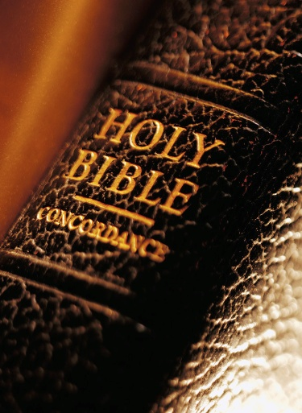
4. Religion in School Curriculum
Religion is a natural part of history, which is included in the approved curriculum in SC.
When the topic is addressed, the emphasis must be purely academic and not devotional.
Schools may teach about religion and its influence on areas such as art, music, literature, and social studies.

Slide 13

5. Religious Content in Student Assignments
Students may express their beliefs about religion in the form of homework, artwork, and other written and oral assignments free of discrimination based on the religious content of their submissions.
Such home and classroom work should be judged by ordinary academic standards of substance and relevance and against other legitimate pedagogical concerns identified by the school.

Slide 14
6. Distribution of Religious Literature
Schools generally shall not permit formal distribution of any materials from any non-school organization, regardless of the content of the materials on school property. Accordingly, students generally should not distribute flyers to all students on a mass level at specific established locations at the school. Students can distribute information on an informal basis that is not disruptive.

Slide 15
More on Distribution of Religious Literature
Students have a right to distribute religious literature to their schoolmates on the same terms as they are permitted to distribute other literature that is unrelated to school curriculum or activities. Schools may impose reasonable time, place, and manner on distribution of religious literature as they do on nonschool literature generally.

Slide 16
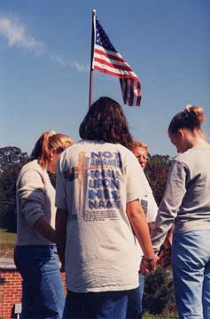
7. Student Participation in Religious Events Before and After School
There is no legal reason not to allow students to participate in religious events “before and after school,” which do not interfere with instructional time or the educational process.

Slide 17

8. Religious Persuasion vs. Religious Harassment
While students may speak about and try to persuade peers on religious issues, students may not be compelled to participate in religious discussions. Persuasion becomes harassment when the recipient of the speech acknowledges his/her desire not to participate. School officials should intercede to stop harassment immediately.

Slide 18
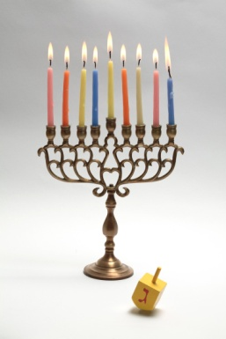


9. Religious Holidays
Although public schools may teach about religious holidays, including their religious aspects, and may celebrate the secular aspects of holidays, schools may not observe holidays as religious events or promote such observance by students.

Slide 19

10. Permitted Absences from Objectionable Lessons in Religion
Administrators and teachers should try to accommodate the reasonable requests of parents and students to be excused from objectionable lessons, discussions, or activities concerning religion.

Slide 20
11. Released Time for Religious Instruction
Subject to applicable State laws, School Boards may allow religious instruction off school property. If allowed, schools may not encourage or discourage participation or penalize those who do attend.

Slide 21

12. Teaching Values
Though schools must be neutral with respect to religion, they may play an active role with respect to teaching civic values and virtue, and the moral code that holds us together as a community. The fact that some of these values are held also by religions does not make it unlawful to teach them in school.

Slide 22
13. Religious Attire
Schools enjoy substantial discretion in adopting policies relating to student dress and school uniforms. Students have no Federal right to be exempted from religiously-neutral policies. Schools may not single out certain religious attire, but must impose the policies as adopted.

Slide 23

14. Federal Equal Access Act
Generally, if secondary public schools have a limited open forum, (allows non-curriculum clubs to meet), the school must allow religious groups the same access to the school media, (PA system, school newspaper, bulletin board).

Slide 24
15. Establishment of Religion
State law, S. C. Code Ann. 59-1-443 (Supp. 2000), requires all schools to “provide for a minute of mandatory silence at the beginning of each school day.”

Slide 25
End of Module
        Click Here to return to the Employee Training Page

